Slide 1
Oprea Darius-Emanuel IVA 1 Jan 2025
Multi-Agent Architecture for Information Retrieval and Intelligent Monitoring by UAVs in Known Environments Affected by Catastrophes - D. Vallejo

Slide 2
Introduction
The paper discusses a multi-agent system using Unmanned Aerial Vehicles (UAVs) to gather and analyze information in areas impacted by natural or man-made catastrophes, such as earthquakes or industrial accidents. The main objective is quickly retrieving data from known environments to help human operators make better emergency decisions.
The system deploys multiple intelligent agents to monitor points of interest (e.g., roads, and buildings) and support crisis management. UAVs, commonly known as drones, are used because of their flexibility, rapid response time, and ability to access difficult-to-reach areas.

Slide 3
Motivation
The authors explain that current solutions for disaster response often lack scalability and flexibility. Traditional robots or drones can only perform limited tasks, and many existing systems focus on single tasks like obstacle avoidance or route planning.
The proposed architecture aims to:
Improve coordination among multiple UAVs.
Enable intelligent analysis of the environment.
Provide decision-making support to human staff during disasters.
The system is designed to be adaptable, allowing the addition of new drones, sensors, and algorithms as needed.

Slide 4
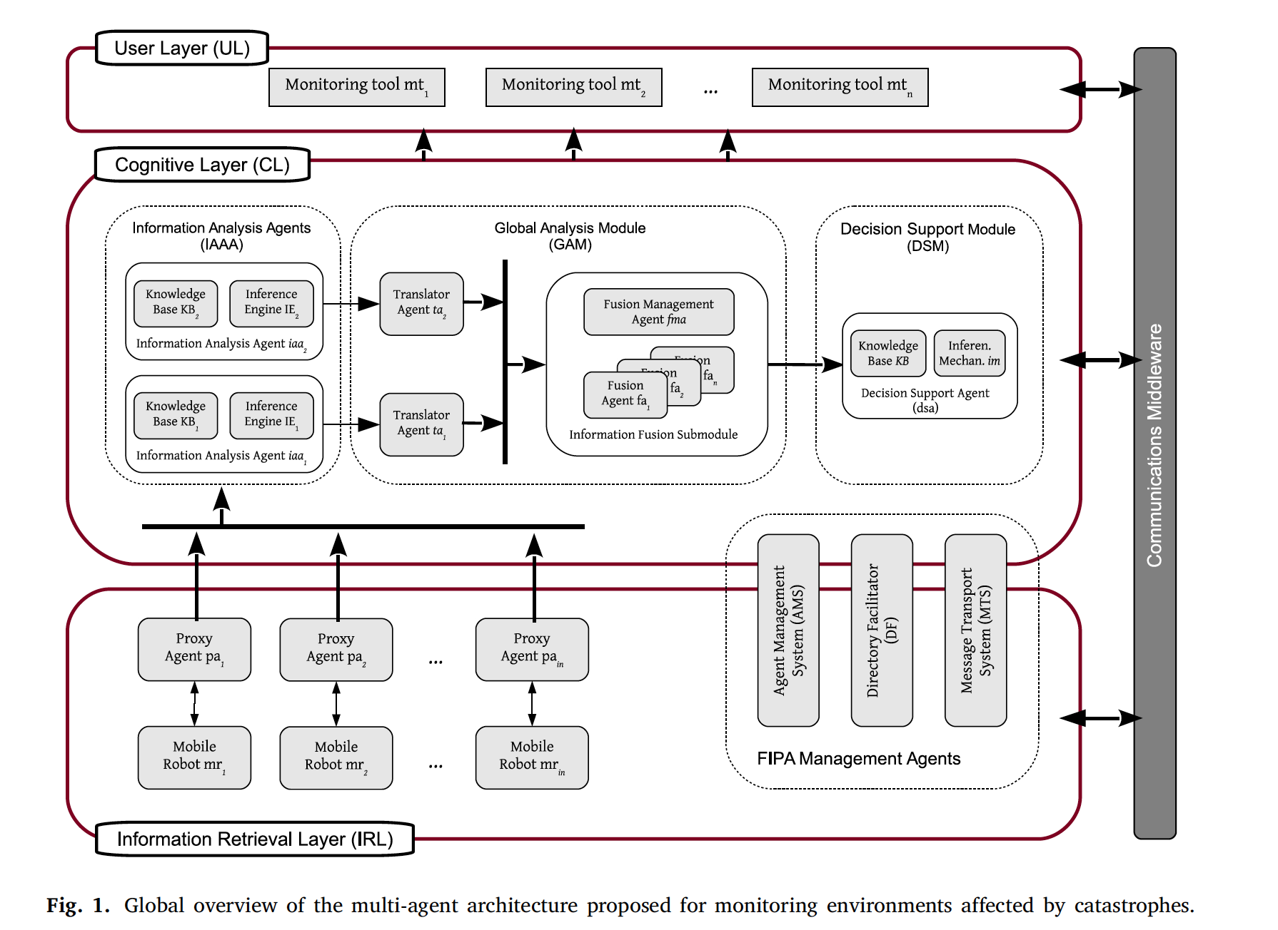
Proposed Multi-Agent Architecture
The architecture is divided into three main layers:
1. Information Retrieval Layer
2. Cognitive Layer
3. User Layer

Slide 5


1. Information Retrieval Layer
This layer is responsible for collecting data from the environment using drones equipped with sensors. Each drone is controlled by a proxy agent that acts as a bridge between the drone's hardware and the software system. The drones gather information like images, temperature readings, and toxic gas levels.
z

Slide 6
2. Cognitive Layer
This layer processes the data collected by the drones and analyzes the situation. It consists of intelligent agents that:
Identify abnormal situations (e.g., spreading fires or toxic smoke).
Share their findings on a shared communication platform called the "blackboard.”
Combine information from different drones to get a complete picture of the disaster zone.
z

Slide 7
3. User Layer
This layer provides human operators with visual tools to monitor the situation and receive recommendations.
It translates the data collected by drones into actionable insights, such as evacuation routes or areas that require immediate attention.
z

Slide 8
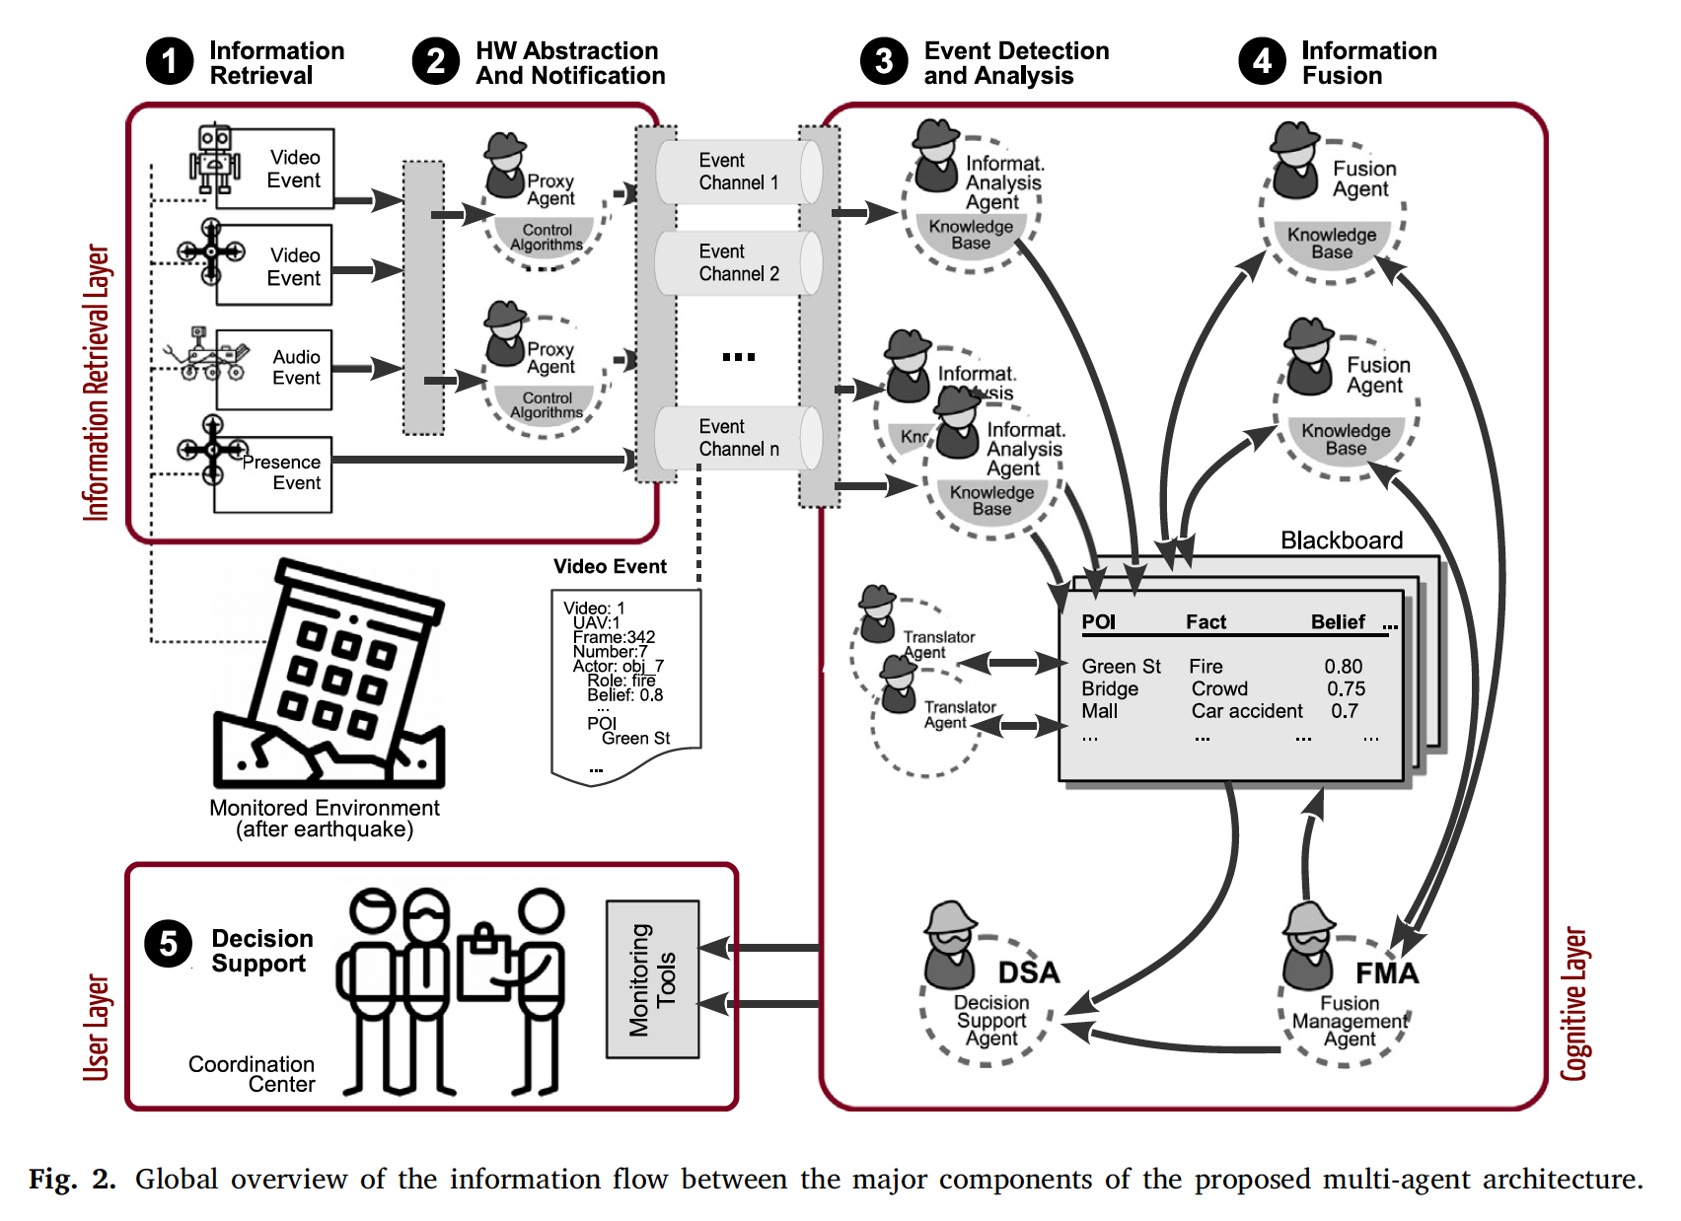

Slide 9
Key Features of the Architecture
Communication Mechanisms: The agents use three types of communication: direct messaging, event channels, and a shared blackboard system. These mechanisms ensure that information flows smoothly between agents and human operators.
Scalability: The system can be expanded by adding more drones or agents without significant changes to the architecture.
Robustness: The system is designed to handle failures, such as a drone malfunctioning during a mission.

Slide 10

Case Study: Industrial Complex and City Scenario
The authors tested their system in a simulated scenario involving an industrial complex near a city. In this scenario, a toxic smoke cloud spreads from the industrial complex after a hypothetical earthquake.
Key tasks performed by the system
Monitoring Exit Roads: The system deployed drones to monitor critical exit roads from the industrial complex to the city.
Analyzing Toxic Smoke Spread: The drones gathered data on the spread of toxic smoke and shared their findings through the blackboard system.
Supporting Evacuation: The system provided recommendations to human operators on how to manage evacuations and reduce the risk to people in the city.
z

Slide 11
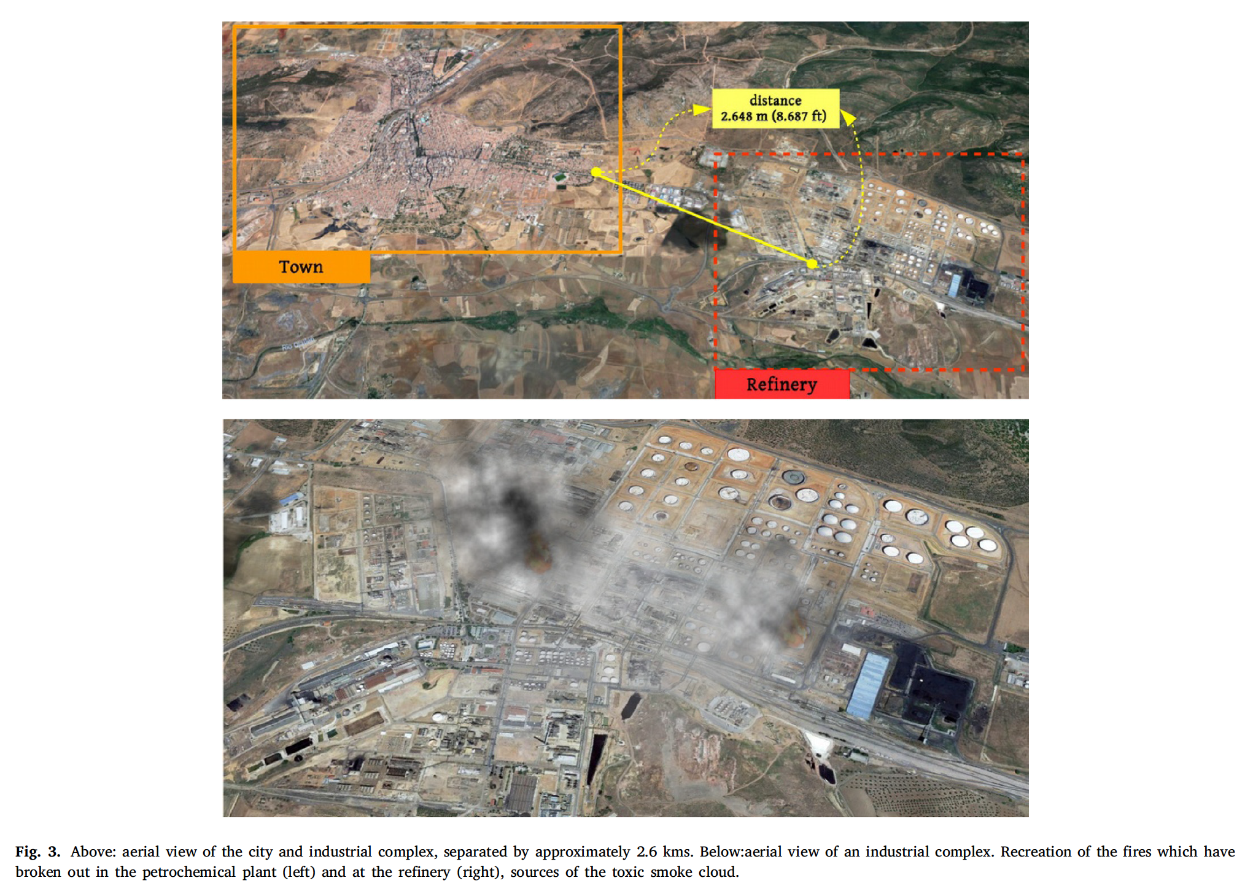

Slide 12
Results and Discussion
The case study showed that the multi-agent system could effectively monitor a large area, detect risks like toxic smoke, and provide valuable insights to human operators.
Advantages of the Proposed System
Faster data retrieval compared to traditional methods.
Better coordination between drones.
Reduced response time in emergencies.
Challenges Identified
The system requires careful planning of drone missions.
Communication between agents can be affected by obstacles in the environment.
z

Slide 13
Conclusion
The paper concludes that the proposed multi-agent system using UAVs is a promising solution for disaster management.
The architecture provides flexibility, scalability, and robustness, making it suitable for various disaster scenarios.
Future Work
The authors suggest further improvements in areas like:
Real-time path planning for drones.
Integration with terrestrial robots.
Testing the system in real-world disaster situations.
z

Slide 14
Key Takeaways
Multi-agent systems can enhance UAV-based disaster management by improving coordination and information analysis.
The proposed architecture allows for quick deployment, intelligent monitoring, and decision-making support.
The case study demonstrates the practical application of the system in a simulated disaster scenario.
z

Slide 15
THANK YOU! OPREA DARIUS-EMANUEL
z

